Slide 1

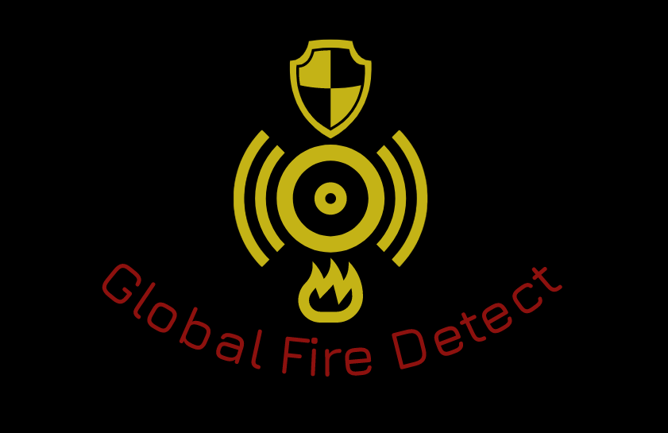

Global Fire Detect
NASA International Space Apps Challenge

Slide 2

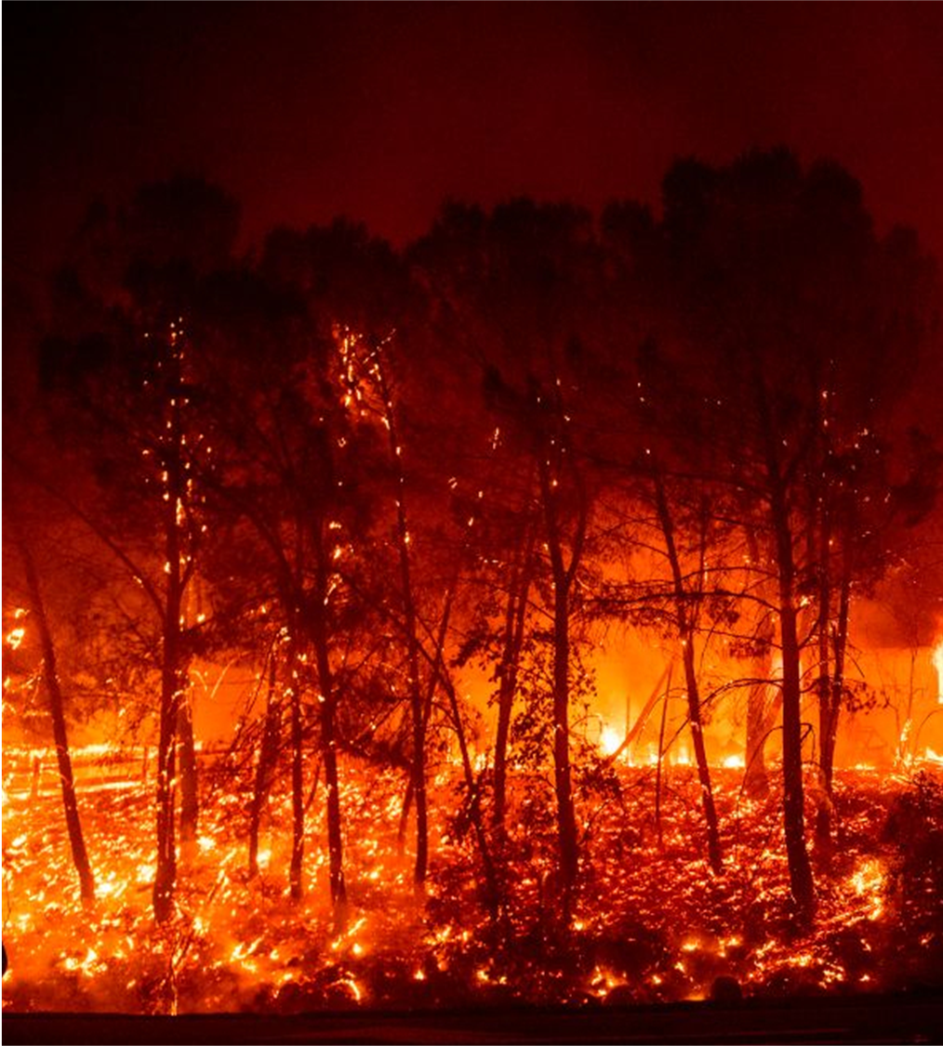
Purpose of the App
Help to prevent forest fires
Alert firefighters when a fire is happening so they can go as quickly as possible
Report to the people what to do in a fire
Provide a map to know which zones are more prone to a fire
Visualize the areas which are most probable to spread the fire.

Slide 3

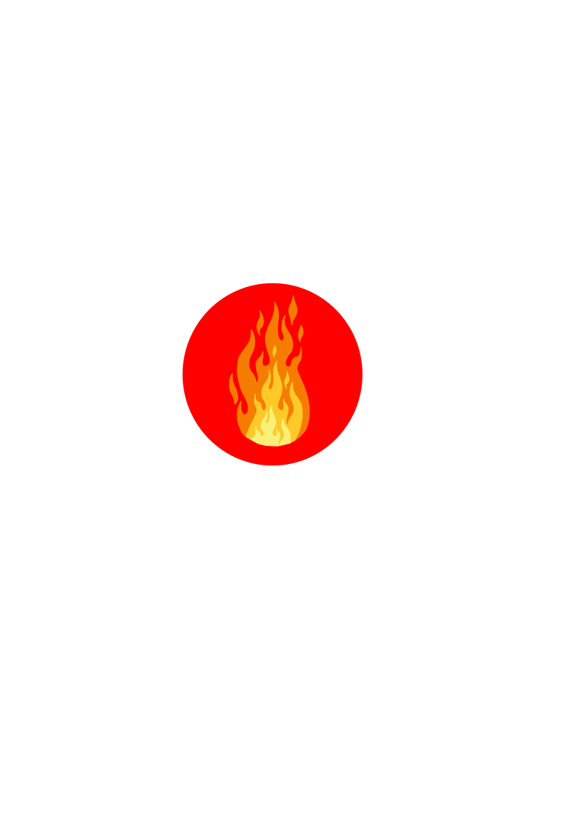
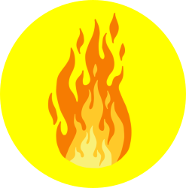

Features of the App
The App has a map that uses the MODIS/SMAP sensors.
On the map are indicated burned zones (red colour).
Zones already burned historically(Orange colour).
Zones with possible fires (yellow colour).
Zones with a low chance of fire (green colour).
POINT:
Burning areas
Possible fire zones
Zones already burned historically
Zones with a low chance or fire

Slide 4
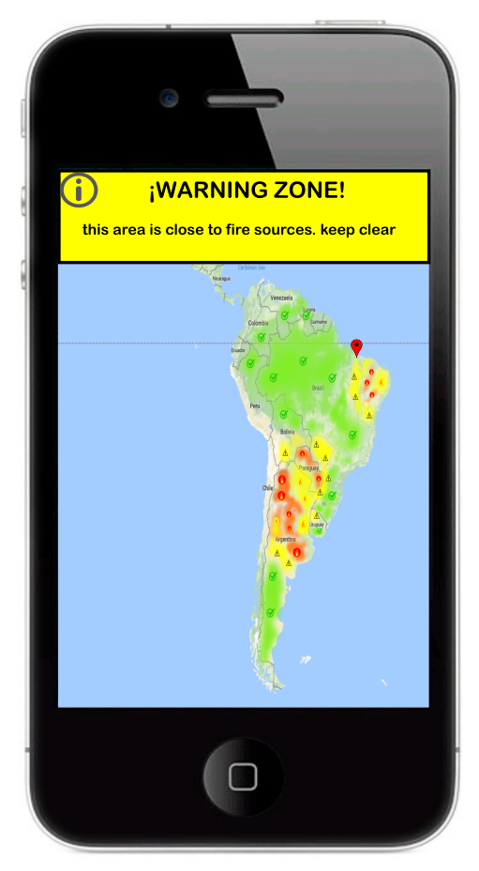
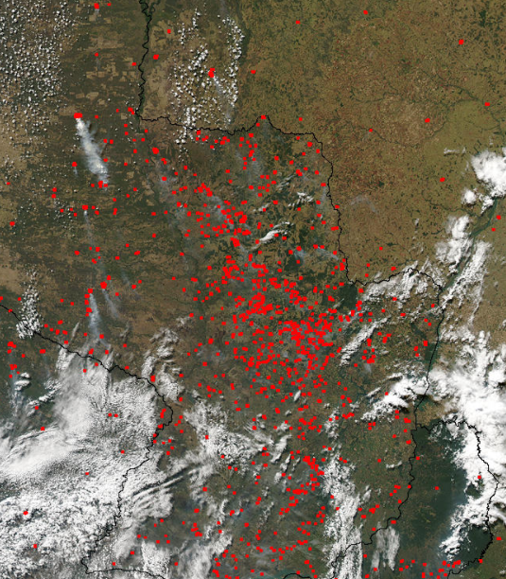
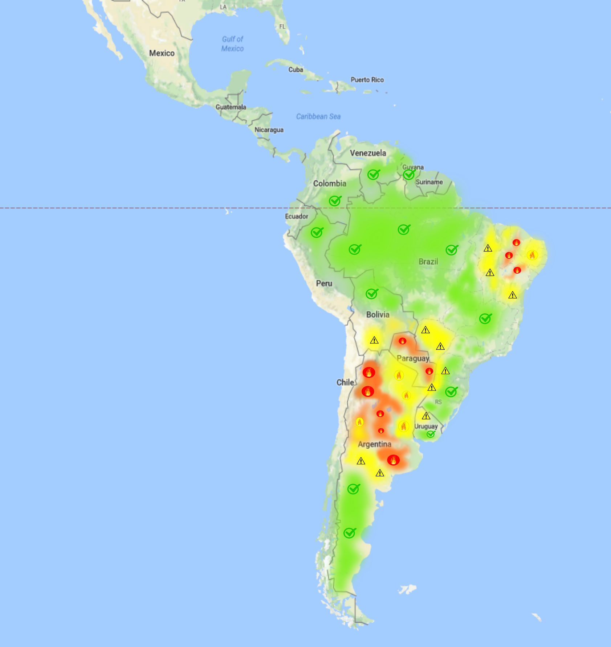
Functioning of the App
General map of the affected zone
Concrete map of the fire zone

Slide 5





Other functions of the App
The App have other good options, like the location of the fire stations, the location of the hospitals, and the location of the hydrant aircraft airports.
Also it counts with a camera, where anyone could take photos to the fires so that the page can be updated and then we can know what are the new zones already burned.
Also it counts with an option to watch the weather.

Slide 6
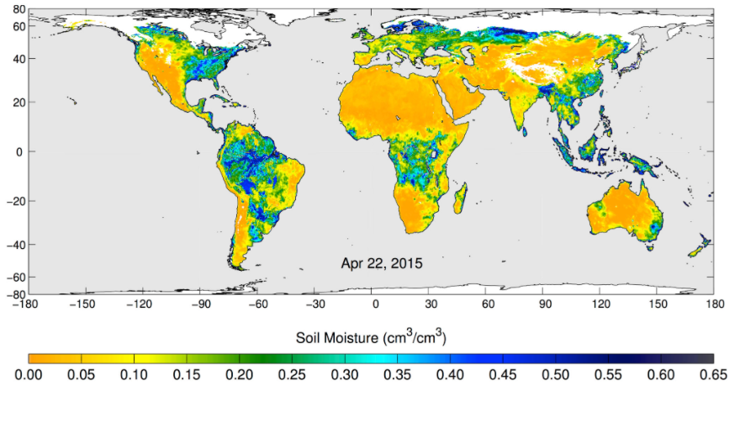
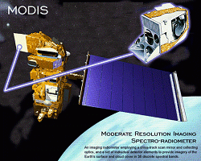
The sensors used in the App
SMAP sensor (Soil Moisture Active Passive): SMAP sensor is designed to measure soil moisture. This allows to observe changes on all the world in timescales ranging from major storms to repeated measurements of changes throughout the seasons. This sensor use the SMAP satellite, and send information everyday to the App, so every 16 hours as much, it been renovated
MODIS sensor (Moderate Resolution Imaging Spectroradiometer): the MODIS sensor is a sensor that identifies the rared radiation emitted by fires. This radiation can be traslated quickly into a map where they are shown all fire spots. This sensor is in the Terra and Aqua satellite.
Drones: It could be used with the App to remove the detected spots by the MODIS sensor and avoid a bigger fire.

Slide 7
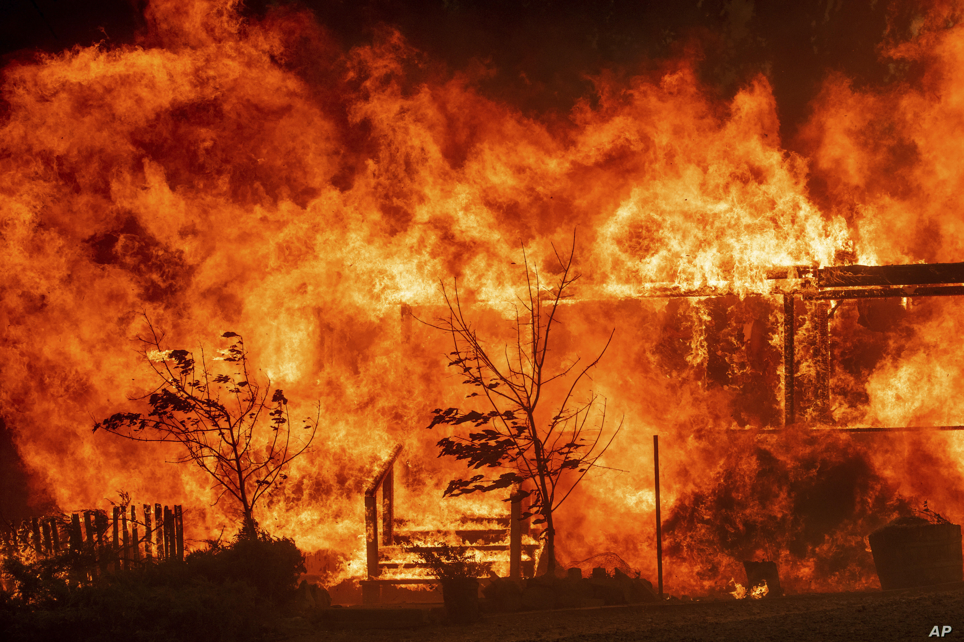
Fire categories
Level I. Small fires. To be controlled, it requires just volunteer staff of the comunities.
Level II. Medium fires. To be controlled, it requires the participation of other institutes like Civil Protection, Secretary of National Defense, Municipal Government and other instances of Estatal Government.
Level III. High fires. It requires the participation and resources of other institutes of the Federal Government.

